Slide 1
A session on MLOps
-Build machine learning models and deploy them on cloud

Slide 2
Focus Points:
What is MLOps?
Difference b/w MLOps and DevOps
Machine Learning Project WorkFlow
An example model building and deploying.
Q&A

Slide 3
What is MLOps?
Machine Learning Operations encompasses a series of procedures, or more precisely, a sequence of actions designed to deploy a machine learning model into a production environment. Before an ML model is deemed ready for production, a number of steps must be taken. These procedures guarantee that your model can be expanded to accommodate a substantial user base while maintaining accurate performance.

Slide 4
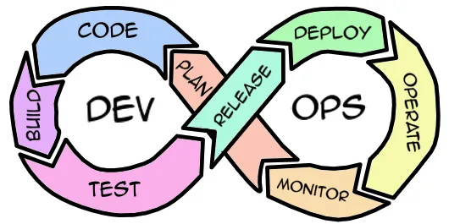
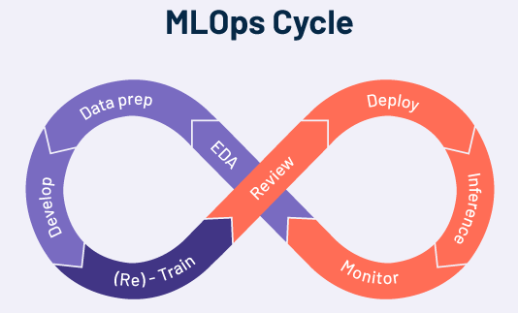
Difference b/w MLOps and DevOps

Slide 5
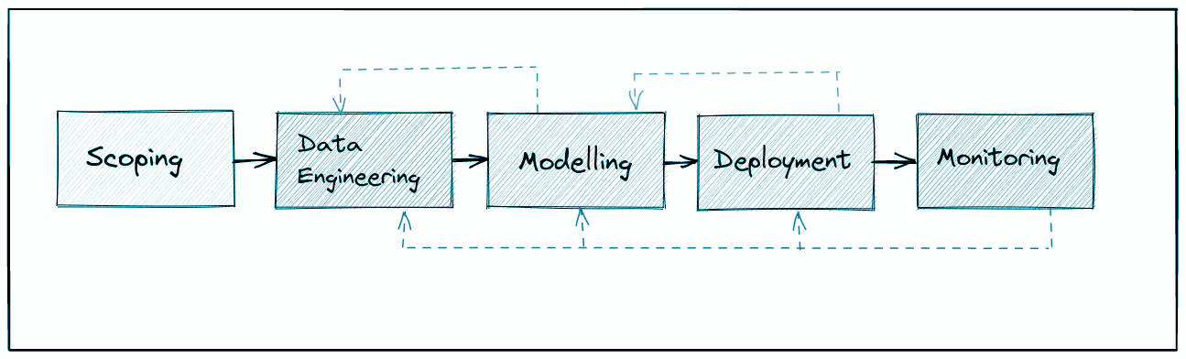
Machine Learning Project WorkFlow

Slide 6
An example model building and deploying.

Slide 7
Any Questions?

Slide 8
Thank You.
Connect with me here:
https://www.linkedin.com/in/jaidev2/
https://www.instagram.com/jai.dev2/

